Slide 1

Good Clinical Practice (GCP) and study specific training for the GENVASC Study
GCP component, endorsed by the Clinical Research Network: East Midlands Training and Development Lead

Slide 2
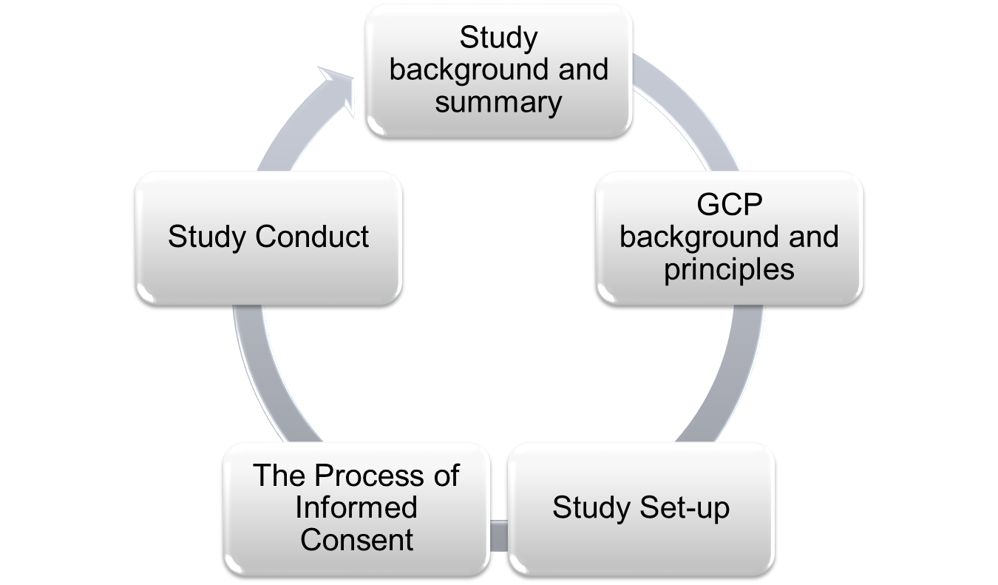

Introduction

Slide 3
Study Background
Coronary artery disease (CAD) is one of the commonest cause of premature death and disability in the UK
Lifestyle factors contribute to risk of CAD and risk scores are used to classify an individual’s risk and target primary prevention measures
Improving accuracy of risk categorisation is a high priority
Inheritance plays an important role
Significant progress has been made in identifying individual genetic variants that affect risk of CAD

Slide 4
Study Background (continued)
Framework for testing whether adding genetic information in the form of a genetic risk score (GRS) can improve current risk prediction of CAD
The NHS Health Check Programme provides ideal opportunity to establish a large and representative cohort
Adopted onto NIHR portfolio
Led by Professor Sir Nilesh Samani and run by NIHR Leicester Biomedical Research Centre-Cardiovascular Theme

Slide 5
Study Summary
Objective
To determine if the addition of genetic information can improve risk prediction of CAD
Target population
All patients attending for the NHS Health Check
Inclusion criteria
40 to 74 years inclusive
Able to give informed consent
Exclusion
Known history of CVD
Known history of blood transmissible infection (e.g. Hep B, HIV)
Duration of recruitment and sample size
10 years (30/03/2022) with a target sample size > 30,000

Slide 6

At the end of this section you will have an understanding of:
The importance of GCP in relation to clinical research studies
An awareness of the main principles of GCP
GCP Background and Principles

Slide 7
Why do we have standards?
Quality of Data
Patient Protection
Ensure that the data about the drug/intervention is valid and reproducible
To ensure safety of patients participating in study is protected
Give public assurance that the data is credible
To ensure that drugs/ interventions we develop are safe for patients in the future

Slide 8
The Policy Framework for Health and Social Care Research
Ensures a common quality standard applied to all research in the NHS
Principles protect and promote the interest of patients, service users and the public in health and social care research

Slide 9
UK Regulations
Other laws and guidelines to be aware of
Data Protection Act 1998
Human Tissue Act 2004
Local Trust Policies
Professional codes of conduct
General Data Protection Regulation Act 2018
Mental Capacity Act 2005
Superseded by GDPR on the 25th May 2018
GENVASC
All study samples allocated a unique study ID at LBRC
Samples are stored in secure LBRC lab
Stored samples are identifiable by unique study ID only
GENVASC
Ensuring participants are able to give informed consent
GENVASC
Information Sharing Agreements
Pseudonymised data
Data held in secure hospital servers

Slide 10
At the end of this section you will have an understanding of:
The regulatory approvals that need to be in place before a clinical trial can be started in the UK
The responsibilities and/or duties of different members of the research team
Be able to identify a range of essential documents
The purpose of setting up and maintaining a site file
Study Set-Up

Slide 11
Responsibilities
The Sponsor, Chief Investigator (CI) and Principal Investigator/s (PI) have defined responsibilities
Your responsibilities:
Study site collaborating agreement
Abide by GDPR, HTA and MCA
Maintain site file
Follow procedures outlined in protocol
Only use approved information documentation

Slide 12
Responsibilities (continued)
Personnel appropriately trained and supervised
Permit supply of clinical data to NIHR Leicester Biomedical Research Centre- Cardiovascular Theme
Permit monitoring at site
Ensure the safety and well-being of participants
Report any concerns about study conduct

Slide 13
Approvals
A study can only start when you have:
A favourable opinion from a Research Ethics Committee
Approval from the HRA
Approval from local Trust/Organisation
Sponsor Green Light
Plus any other relevant approval: i.e. MHRA (drug study)

Slide 14
Essential Documents
These are documents which permit the evaluation of the conduct of a trial and quality of data produced
Demonstrate compliance with GCP and regulatory requirements e.g.
Protocol
Approval documentation
Information sheet/consent form
Relevant correspondence
CV’s of personnel involved in study

Slide 15
Site File
All essential documents are stored in designated file
Kept in designated place and maintained by designated person
Secure area
Limit access
Protect from damp, fire etc.
Provided at start of trial and maintained throughout
File chronologically with most recent uppermost
Label superseded documents but do not destroy them
Archive
Minimum 5 years
Must not be destroyed at site
Stored securely, adequately protected, controlled access

Slide 16
Protocol Amendments
Substantial amendments require a favourable opinion from the REC, HRA and local Trust/Organisation before they can be implemented
Except where urgent safety measures need to be taken
Amendments may result in changes to other essential documents (e.g. PIS/ICF)
New versions must not be used until appropriate approvals are obtained
Version control
All study documents must be version controlled

Slide 17
Informed Consent
At the end of this section you will:
Understand your responsibilities in the consent process

Slide 18
What is informed consent?
ICH-GCP E6 Document 1.28 (1996)
A process by which a subject voluntarily confirms his/her willingness to participate in a trial, after having been informed of all aspects of the trial that are relevant to the subjects decision to participate. Informed consent is documented by means of a written, signed and dated Informed Consent Form.
In order to be valid, consent should be:
Voluntary
Informed
Competent

Slide 19
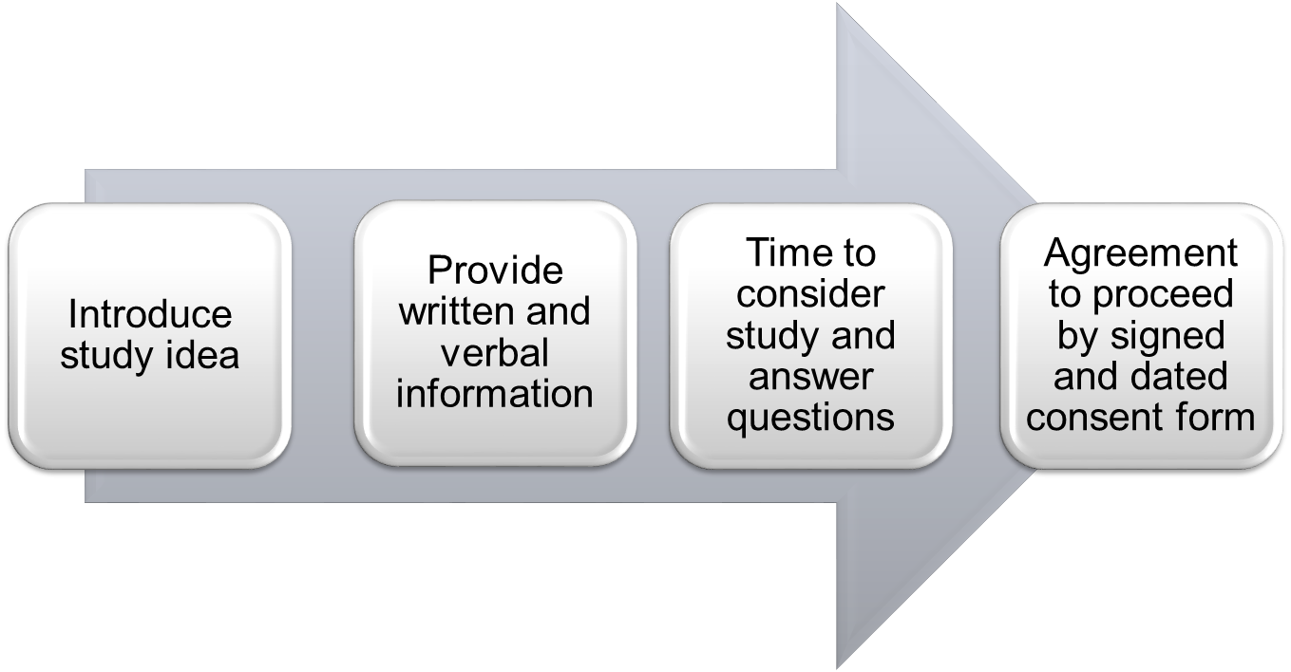
The process of informed consent
At same time as NHS HC invite or opportunistically. Delivered via text link to website, invite letter or verbally
Abbreviated information
(opportunistic/NHS HC appointment, witnessed)
Full information (NHS HC Mailshot, unwitnessed)

Slide 20
Witnessed consent process
The witnessed process can be used opportunistically when patients attend for a clinical visit and have a NHS Health Check
or when they attend specifically for a NHS Health Check
Discuss concept of study
If interested provide verbal information

Slide 21
Provide information
Verbal information
Key points to relay to participant:
Purpose
Voluntary/right to withdraw/will not effect their care
What will they have to do: consent, blood sample (DNA), permit use of data
Storage of samples and data
Confidentiality
Contact/further information

Slide 22
Witnessed consent process -
Providing further information
Written information:
Provide the participant with the abbreviated participant information sheet (version 3 12/09/2013) to read prior to consent
Provide detailed participant information leaflet (version 4 12/09/2013) to take home and read later
Only use Information sheet and consent form approved by REC/HRA and Sponsor Green Light
Must not be changed except by formal amendment
Multiple languages available

Slide 23
Information (continued)
Establish level of understanding
Mental capacity act (2005)
A person is able to make a decision for themselves if they are able to
Understand information relevant to decision
Retain the information
Use or weigh the information
Communicate their decision (by any means)
Answer questions
Provide time to consider participation
No study data is acquired or samples analysed for 30 days to allow more time to consider participation

Slide 24
Agreement to proceed
Informed Witnessed Consent Sheet
Produced from electronic patient record: Version 4.2 (12/09/2013)
Relay each point verbally
Participant to initial boxes (not tick)
Participant to print name, sign and personally date
Researcher to print name, position, sign and date
Consent form filed with Information Sheet
1. Original in site file
2. Copy in primary care records (electronic records)
3. Copy to participant
4. Copy with study sample

Slide 25
Optional consent
Optional consent field number 7: to be contacted in the future for potential participation in additional studies
Lack of consent for this aspects does not preclude participation into study
Participant to initial box to consent or cross box if they do not consent to this optional element

Slide 26

Witnessed ICF template

Slide 27
Optional consent
Optional consent field number 7: to be contacted in the future for potential participation in additional studies
Lack of consent for this aspects does not preclude participation into study
Participant to initial box to consent or cross box if they do not consent to this optional element

Slide 28
Unwitnessed consent process
To be used in conjunction with postal invite for the NHS Health Check or provided prior to attending NHS Health Check. Patient must have time prior to their appointment to read the detailed participant information sheet
In case of invite via NHS Health Check mail out:
GP study specific invitation letter can be used (version 1 28/04/2014) or the approved paragraph about GENVASC incorporated into the NHS Health Check invitation letter (version 1 21/04/2016)
Detailed participant information leaflet (version 4 12/09/2013) included
Unwitnessed consent form (version 1.1 12/09/2013) included

Slide 29
  Agreement to proceed –
  Unwitnessed consent process
Patients wishing to take part in the study return completed unwitnessed consent form to healthcare provider (GP, Nurse, HCA or Phlebotomist) when attending for their clinical Health Check appointment
Consent form must be checked for completeness:
If patient ticks ‘no’ in any boxes (other than last optional element), the consent form is not valid
Check level of understanding and answer any questions
Copies of consent form required as per witnessed consent process

Slide 30
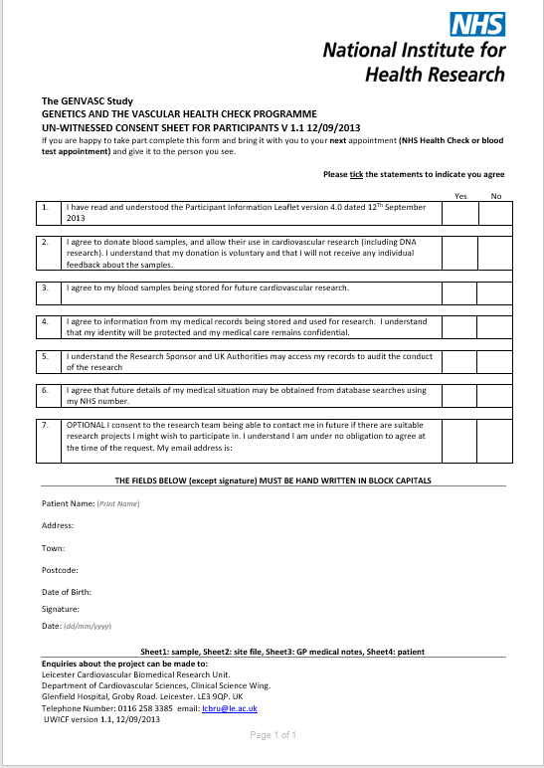
Unwitnessed ICF template

Slide 31
Withdrawal
All consented participants must be provided with a copy of withdrawal form (V1 27/04/2012)
Participants can withdraw at any time and do not have to provide a reason
Participant that want to withdraw, complete withdrawal form and return directly to study team
Freepost number is included on withdrawal form
They can indicate whether samples/data already collected can be used or destroyed
Document in patient notes if you are made aware of a withdrawal

Slide 32
Document the process
It is a Research Governance requirement to document the recruitment process
Any research activity must be recorded in the participant notes, i.e. recruited, declined or withdrawn consent
There are generic research read/snomed for use on electronic patient record. Free text must be used to reflect that the research activity relates to GENVASC
For example: Participant attending for NHS Health Check and suitable for the GENVASC study. Information sheet/s and withdrawal form (include version numbers) provided. Study discussed and participant happy to proceed, consent obtained, samples taken.
Entry will be date and time stamped according to login details

Slide 33
Study Conduct
At the end of this section you will:
Understand how to record study data
Know how to record and report a protocol deviation
Understand how to process study samples At the end of this section you will:
Understand your responsibilities in the consent process

Slide 34
Recording Data
Sample bottles & consent forms:
Records must be accurate, legible and complete
All fields must be completed
Any change should be initialled and dated
Strike through original entry with single line (should not obscure original entry)
Always use black or blue pen
No abbreviations
If its not documented it did not happen

Slide 35
Protocol Deviations
The Protocol must be followed at all times. However, occasionally deviations to the approved protocol may occur. If this happens:
Record in the patient notes
Report to study team

Slide 36
Data and Anonymisation
      There is a secure GENVASC database, which holds:
      Participant demographics
      Cardiovascular risk factors/scores
      Relevant health information extracted from GP practice databases and hospital systems
      Over time this database is populated with additional relevant participant health information
      All participants are allocated a unique study identification number to pseudo-anonymise data
      Data is gathered using participant NHS and System numbers
      Information Sharing Agreements are in place between data controllers (GP practices & the study team) and data processors (BRC contracted Data Processor)

Slide 37
Sample collection/processing
Ensure informed consent is obtained prior to taking any study samples
Obtain clinical samples in their normal order first, followed by the study samples
Study samples can be drawn separately from a second needle if necessary
GENVASC study samples are optimally 10ml of blood using your routine EDTA blood sampling tubes. For example:
2 x EDTA 4.0ml tubes
3 x EDTA 2.7ml tubes
1 x EDTA 10ml tube
2 x EDTA 4.9ml tubes

Slide 38
Sample collection/processing (continued)
Label tubes with patient demographics and date
Bag samples separate to clinical samples, affix a bag label and attach a copy of the consent form
Send study samples to pathology alongside clinical samples, using routine pathology service
If no research sample are obtained, just send the participant consent form in a labelled sample bag

Slide 39
Portal Registration & Sample Tracking
When the samples arrive at LBRC they will be registered on the GENVASC portal (N3 protected and secure)
The Portal allows for accrual, quarterly reimbursement reporting and document management
https://genvasc.uhl-tr.nhs.uk
Each member of staff working on the study will be provided with their own Portal login
Staff can only access their own practice instance of the Portal

Slide 40
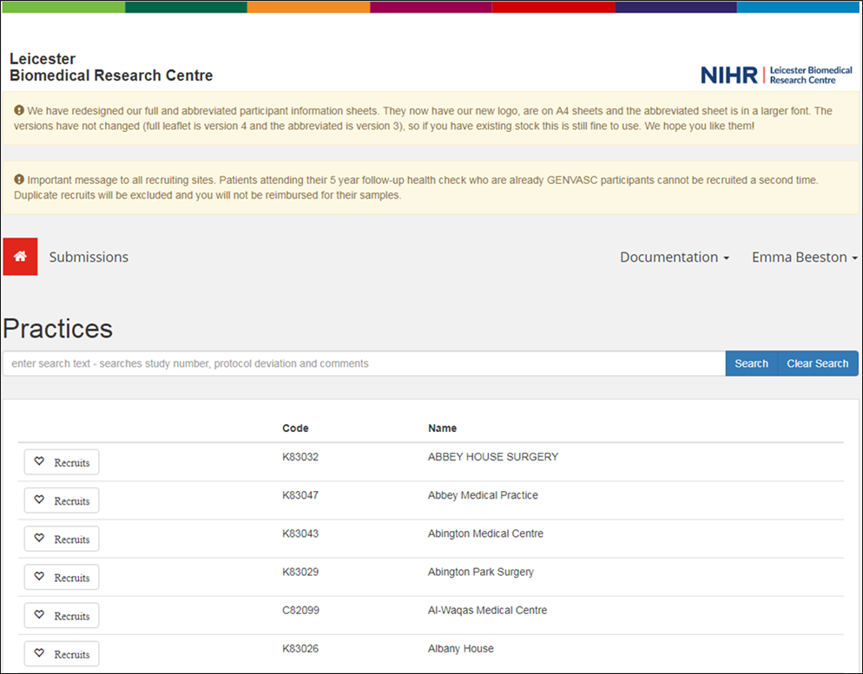
Portal

Slide 41

ANY QUESTIONS?

